Slide 1
Interview Skills
By Group 4

Slide 2
What’s covered ?
Preparation
General Skills “Do’s”
General skills “Don’ts”
Common questions
Shaun
Ruomu
Julian
Riwu

Slide 3
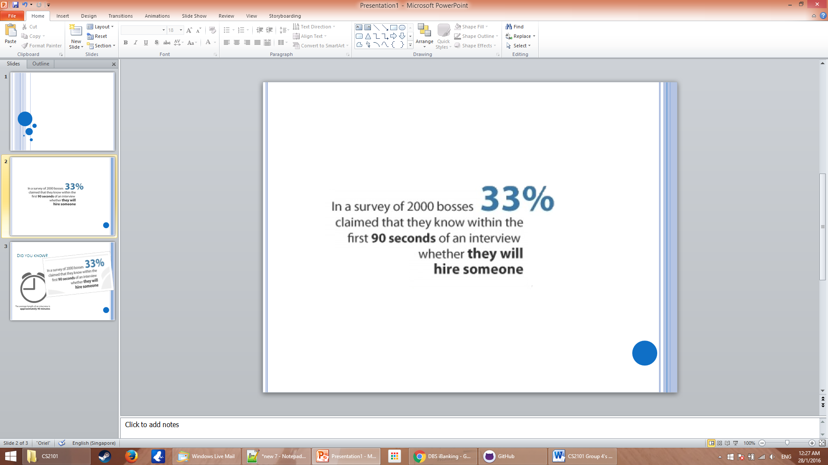
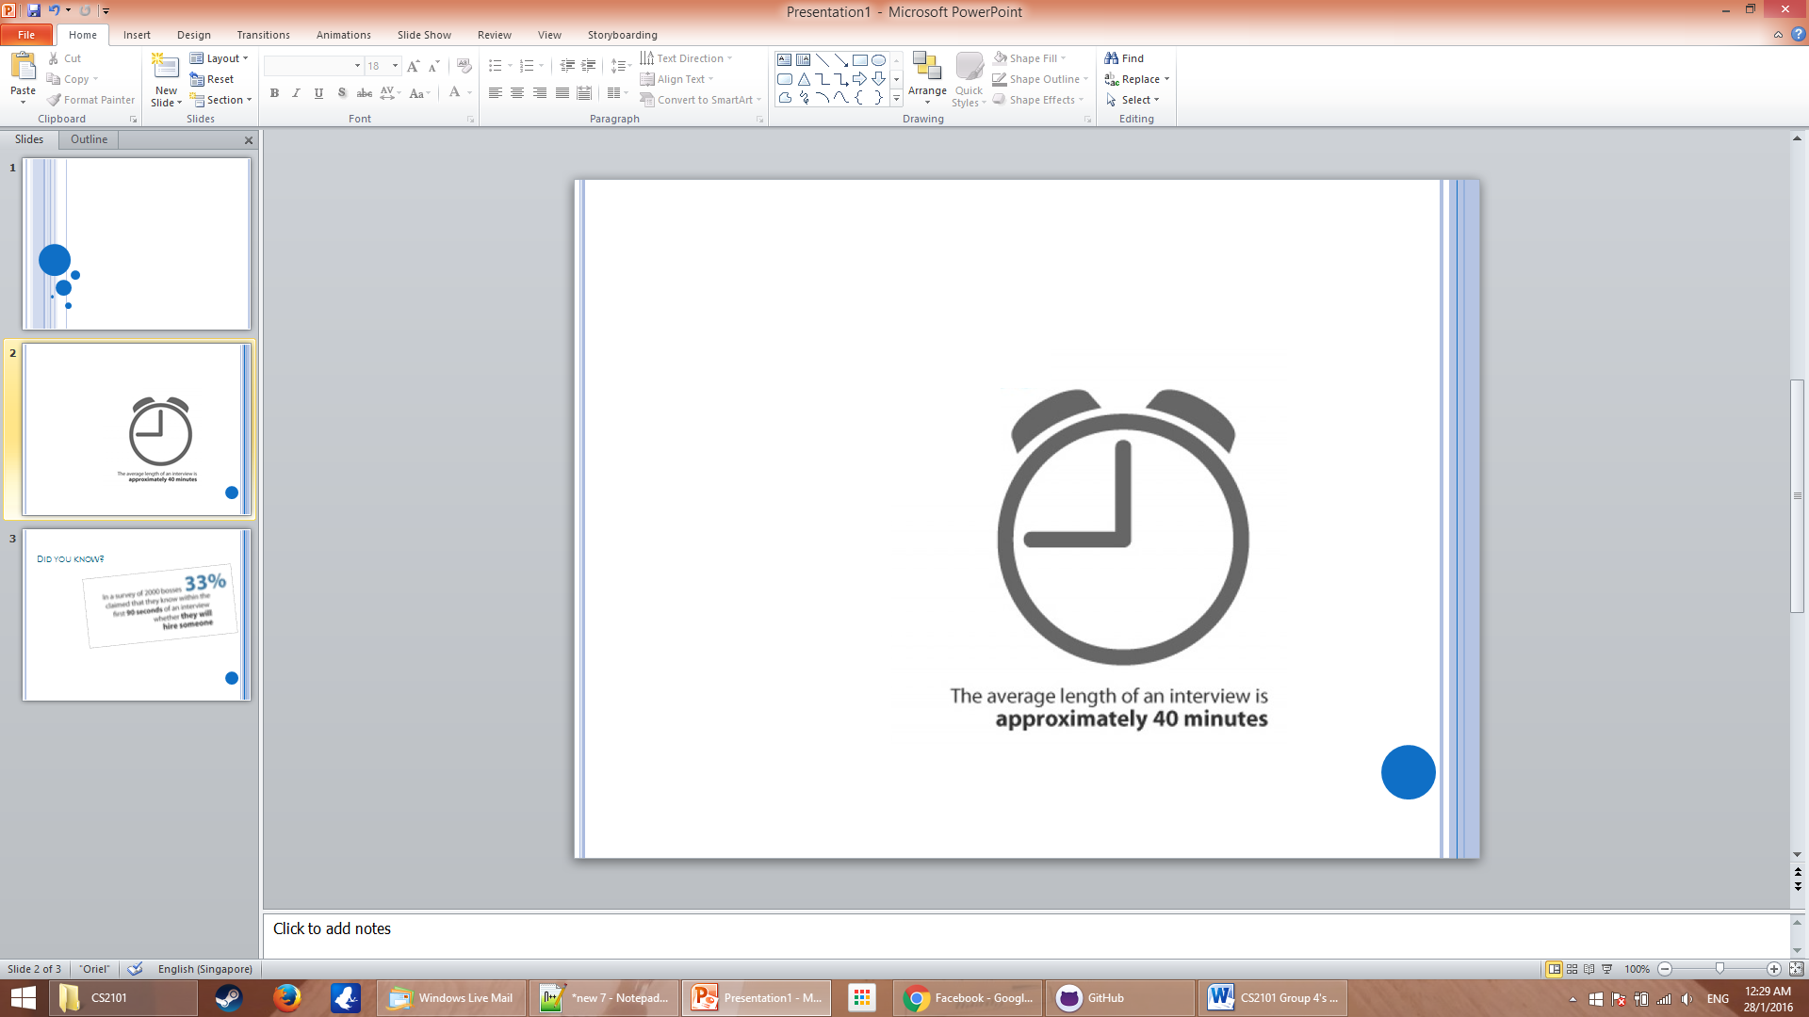
Did you know?

Slide 4
Know thyself
Prepare for Commonly asked questions
Tell me about yourself/Strengths/Weaknesses
Prepare but avoid memorizing a script
Know your CV/resume
Potential questions ? ( past projects )
Bring in portfolio or past project to show

Slide 5
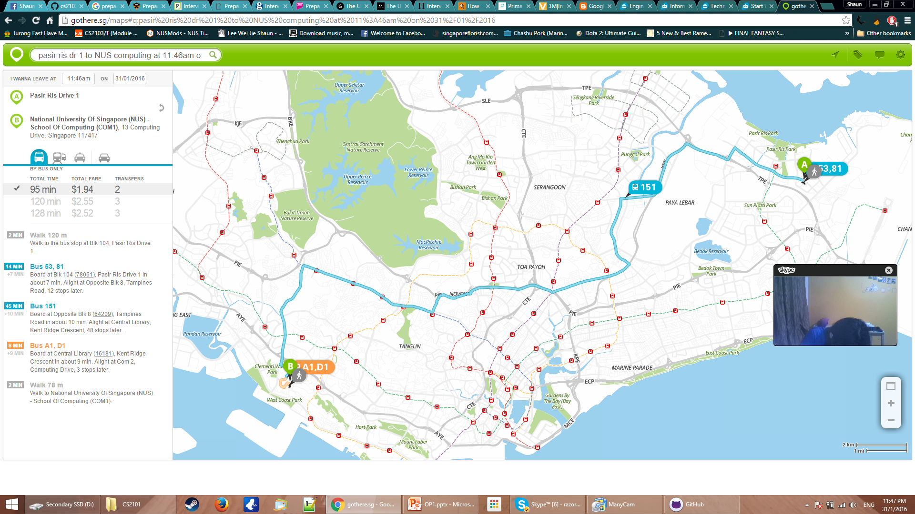
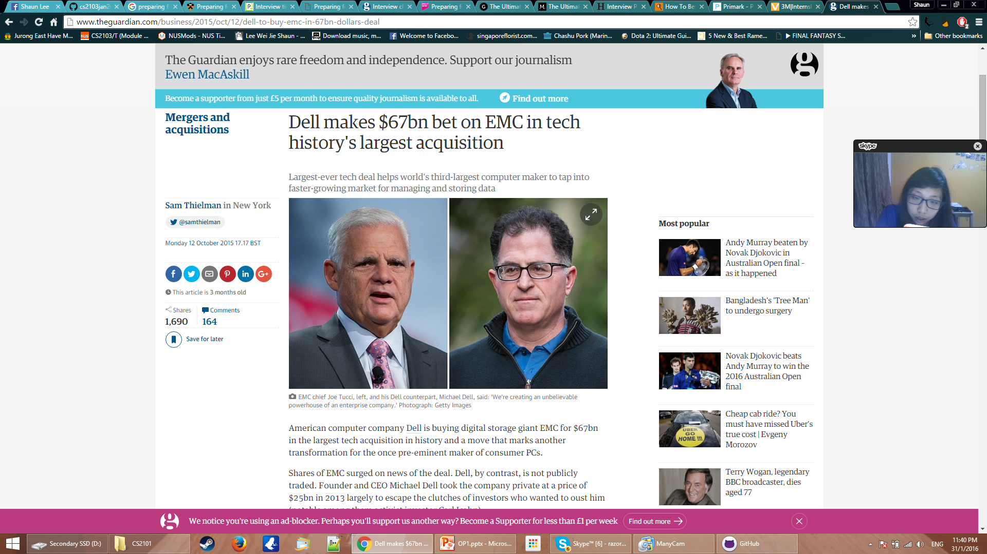
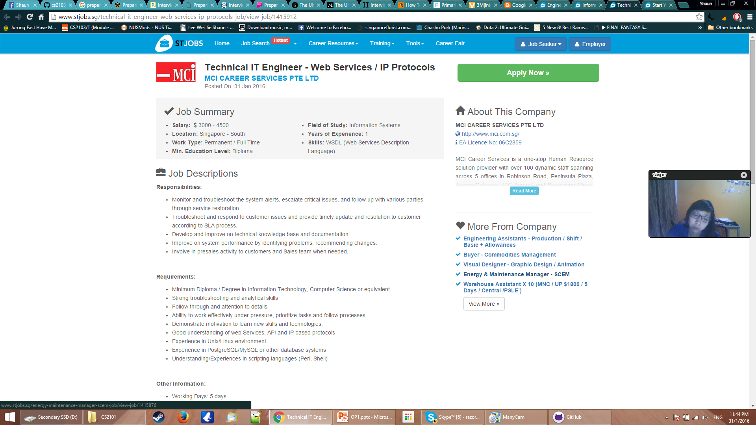
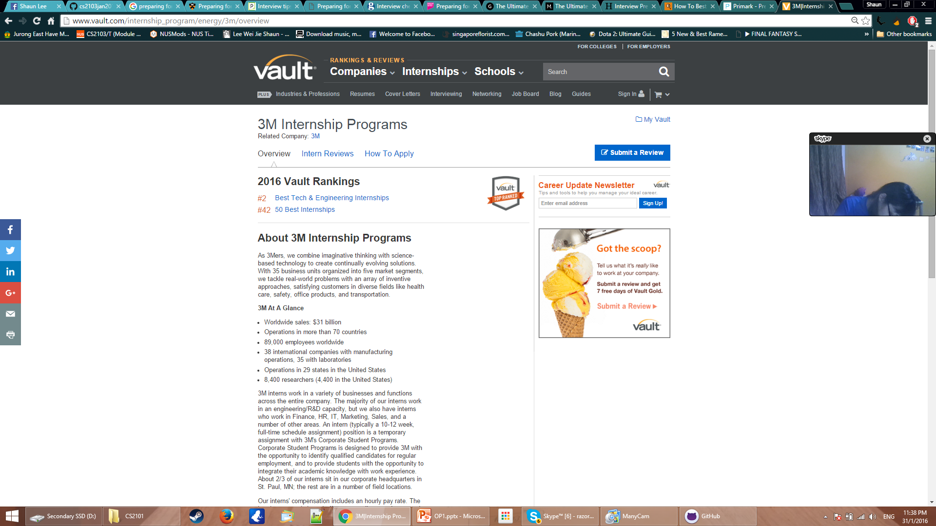
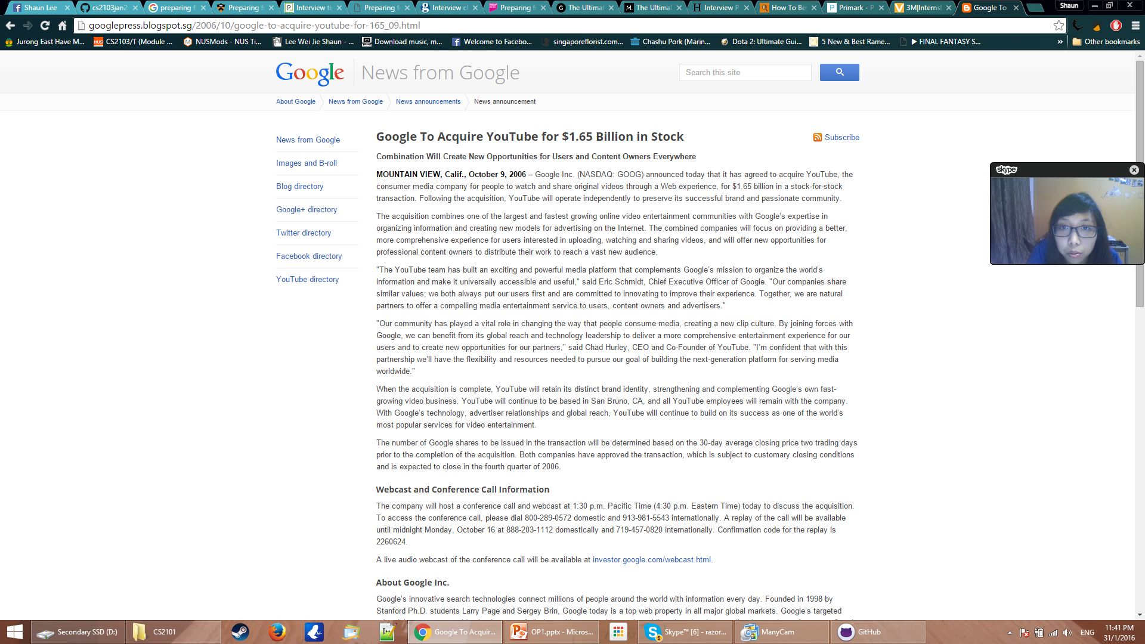
Know thy “enemy”
Company’s profile & background
Tools : Vault, CareerSearch and Wetfeet
News about Company & Competitors
Job requirements and key responsibilities
Route and time taken to travel (gothere.sg)

Slide 6
First Impression counts
Dress accordingly
Groom yourself
Smell good
Feel good

Slide 7
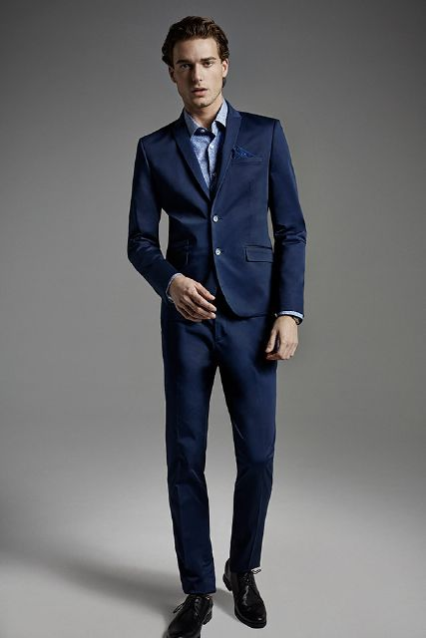
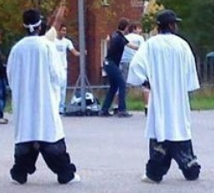
Dress accordingly
Smart casual ? Formal ? Clarify when in doubt
OR
Notes:
General rule of thumb - Better to be overdressed than underdressed

Slide 8
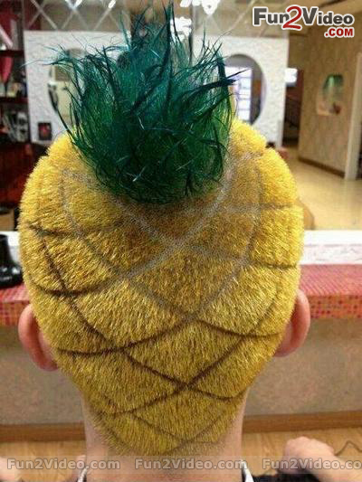
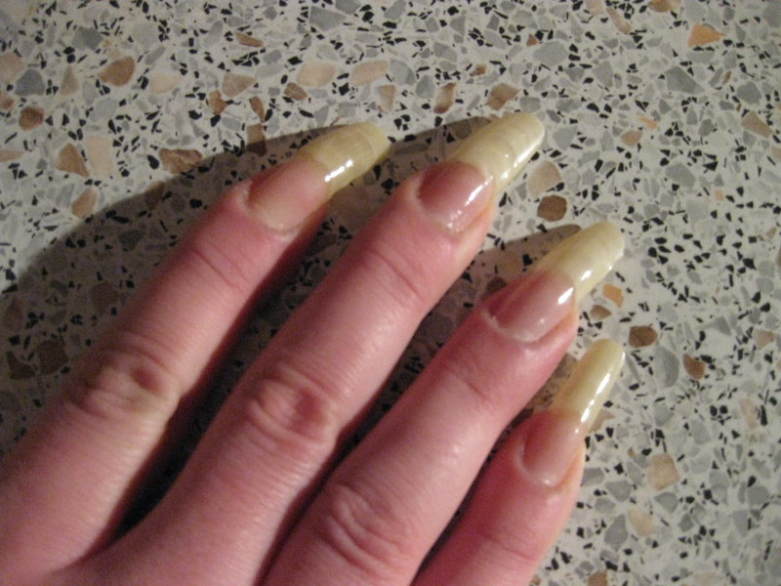
Groom yourself
Haircut, nails, facial hair
Notes:
You want to look presentable, not like these

Slide 9
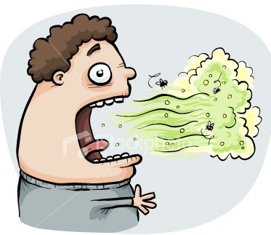
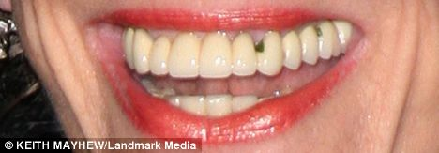
Smell good
Deodorant instead of overpowering perfumes/cologne
Don’t smoke or eat right before interview
Notes:
Bad impression and unsightly

Slide 10

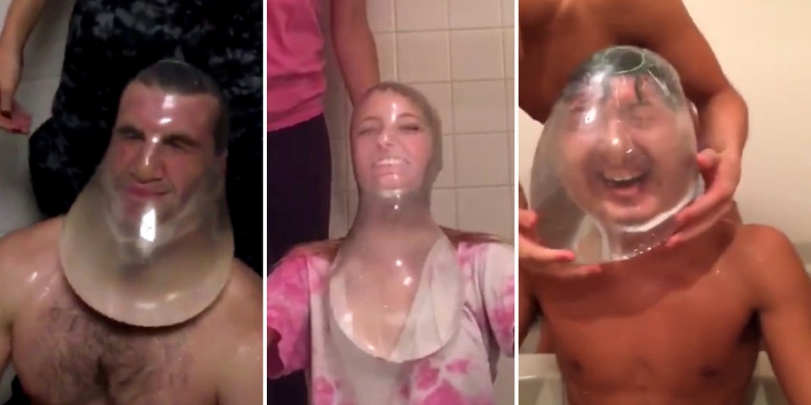
Feel good
Sufficient sleep the night before
Hydrate yourself

Slide 11
Preparing for success
“By failing to prepare, you are preparing to fail – Benjamin Franklin

Slide 12
General skills: “Do's
Body management | give relevant answer

Slide 13
Manage your mind
convey
Body
Mind
control
Fidgety movements
Defensive position
Avoid of eye contact
Lack of energy
Nervousness
Lack of confidence
Untruthfulness
Boredom
Notes:
Body language conveys more information about your mind state than the spoken language, so we need to manage our body language in interviews. Our body and mind are close related. People infer our mind-state from our body movement, because our body movement is determined by our mind-state.
Manage of body movement is essentially the management of our mind state.
Mind comes first.
Confident people naturally look convincing and passionate people naturally uses body movement to convey ideas.
If the mind is nervous, you cannot stop being look nervous. You may try to stop scratching the hair, but you may not notice your voice is shaking. There are endless list of things to be fixed if the mind is not prepared.

Slide 14


Give relevant answers
Know what are the interviewers looking for.
Fit your ability into their requirement.
Notes:
You and your interviewer meet for a purpose. With the limited time, you need to give your interviewers as much evidences as you can to convince him/her that you fit the requirement for the opportunity.
This is so important as I want to share about my personal experience here.
I have failed the USP interview…. Because…

Slide 15
Give relevant answers
Sales Executive / Manager*
Performance driven company
Support sales team effectively
Design attractive commission scheme
*Source : http://www.stjobs.sg/sales-executive-manager-job/view-job/1412928
Notes:
This is an job description taken from the Stjobs website. The left-side is the text description which is not supposed to be read. On the right I have extracted 3 points from the job description.
So how should you fit yourself in the job description?
Performance driven: it stresses on the meritocracy nature of the company. Monetary result is the most essential quality for them. Do not discuss your vision and values, but share with them your working experience. You may want to talk about how did you achieve above-average result in your field. E.g. in preparing of the final exam, knowing that I am unable to get all the As, I do detailed revision for the courses I am good at to ensure an A and trying all the past-year papers for the modules which I am not good at to quickly improve my grade, finally I secured my second-class honor.
Support: being responsive and know how to resolve team collaboration problems
Attractive scheme: tricky part, it is not difficult to design an attractive commission scheme. Giving more money is apparently more attractive. Unfortunately, this requirement is asking you to exploit your co-workers to the largest extent with as little rewards as possible. How to respond to such a requirement? This is an art, not a science, so you need to show them you are a successful, exploitive person. E.g. I am very strict at my co-workers, because I can give them an offer that they cannot resist. For example, ….

Slide 16
Know better from questions
How the company wish you to treat others is how the company will treat you.
Decide if the opportunity is really what you want.

Slide 17
General skills: “Don’t”s
Communications| Behaviour
Notes:
Good afternoon everyone, I am Julian and today I will be presenting on the “don’t”s of an interview. In particular, I will be covering the communications and behaviours that an interviewee should try to avoid if he, or she, is going for an important interview.

Slide 18

Communications
Don’t answer vague Questions
Unnecessary risk
Best/Worst Scenario
Photo by: Brian Moore, https://flic.kr/p/weYd8
Notes:
Don't answer vague questions. Rather than answering questions you think you hear, get the employer to be more specific and then respond.
Answering vague questions only create opportunities for you to potentially blurt out something totally irrelevant.
In the best scenario, you answer the question accurately, in the worst, you create a bad impression for yourself.

Slide 19


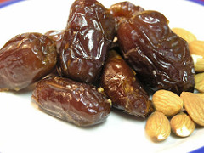
Communications
Avoid Ambiguity
Photo by: Kate Hopkins, https://flic.kr/p/2Q66A
Photo by: Marko Kaariainen, https://flic.kr/p/qsbnWb
Date:18/2/2016 Drink Wine Day
Photo by: More Good Foundation, https://flic.kr/p/8Q5KMV
Notes:
In conjunction with not answering vague questions, it is also important to remember that there exists a fine line where clarifications become redundant.
Once when applying for a spot in a fraternity, I was asked in an interview what my ideal date would be like. As I was ill-prepared for that interview, first there was a long bout of silence while I pondered what the interviewer probably meant by “date”. On hindsight, it really should’ve been obvious in what context the interviewer had meant when using the word “date”. Then, when it hit me, I came up with the most ambiguous answer ever,”I think my ideal date would be two people who get along and they would go out and enjoy themselves.” Needless to say, I didn’t get the spot.
Avoid ambiguity whenever possible and try to narrow down the scope of your answers.

Slide 20
Communication
Ask what the company can do for you
“When I interview a person, I expect the person to be asking how he can add 2.5 times of his salary’s worth to my company’s value, not what my company can do to facilitate his personal growth.”
My mother
Notes:
Do not ask what a company can do for you. Here is a quote from my mother, who has ran multiple companies in various countries, over the span of more than 20 years.
Employers, like my mother, seek employees who can produce quality work. Employers do not owe it to employees to teach them. Instead, employees are expected to be proactive enough to seek their own personal growth to bring about more value to the company.

Slide 21
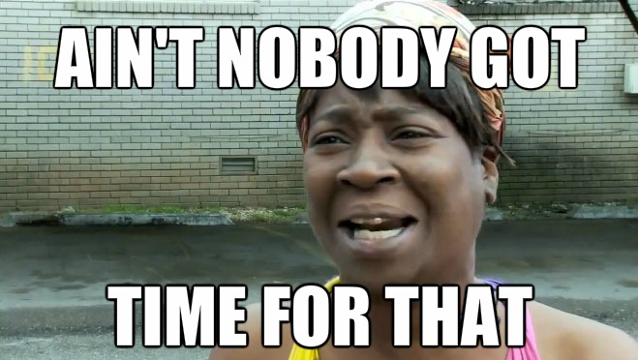

Communications
Interruptions
Time to listen
Bad working attitude
Photo by: Kurt Bauschardt, https://flic.kr/p/kcc2QD
Notes:
Never interrupt the employer. If you don't have time to listen, neither does the employer have time to listen to you.
Additionally, this can only spell out a bad working attitude from you in the future if the employer chooses to hire you.
This will lead him or her to reconsider whether to give you the job.

Slide 22

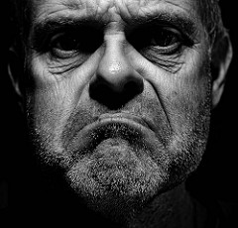
Communications
Previous or present work partners
Not a team player
Bitter person
Photo by: Craig Sunter, https://flic.kr/p/zTu1PY
Notes:
Do not make derogatory comments about your present or former employers, colleagues or companies.
This does not bring reflect good on you as it only portrays you as someone who is not a team player or a good subordinate.
Deriding your past or present work partners can make you look like a bitter person who might potentially cause unhappiness in the workplace if you join the employer’s company. This is clearly undesirable. Look at this guy, would you hire him ?

Slide 23
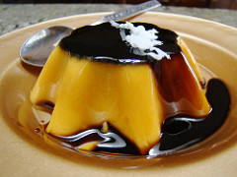

Behaviour
Chewing gum/Eating Food
Sloppy Attitude
Off-putting (pudding)
Photo by: Vegan Feast Catering, https://flic.kr/p/8BybqB
Photo by: Veronica Aguilar, https://flic.kr/p/oDU2kk
Notes:
Eating food in almost any interview is a big no-no.
It conveys to the employers a sloppy attitude and lack of seriousness pertaining to the interview.
Additionally it can be off-putting if you are talking and there is food in your mouth.

Slide 24

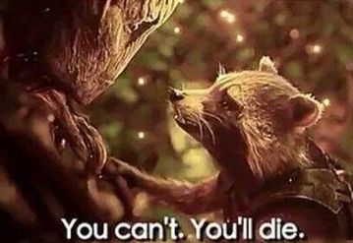
Personal grooming
Smoking
Avoid smoking before
Mints/mouthwash
Photo by: Niq Scott, https://flic.kr/p/6LzREQ
Notes:
Ok smoking, I am not referring to making up answers on the spot.
I don’t know if any one of you here smoke. If you ever decide to pick up the habit, please do ensure to avoid smoking before an interview. It creates an unpleasant odour and results in an overall bad first impression.
Additionally, bring some mints and mouthwash to ensure that your breath is free of the smell as well.
Even if the interviewer offers you a cigarette, do kindly decline. Alternatively, you can kick the habit between now and that interview. It can be done, I did it.

Slide 25

Personal grooming
Heavy perfume/cologne
Photo by: edmondwong8, https://flic.kr/p/73PURc
*Source : http://cals.arizona.edu/clubs/manrrs/MANRRS%20Web/GENERAL%20INTERVIEW%20TIPS.pdf
Notes:
Smell is a very subjective thing, and the scent that you like might not be one that your potential employer likes.
On top of that, wearing strong perfume or cologne distracts the employer from the interview at hand and does not help you when you are trying to promote your expertise.

Slide 26
Common Questions

Slide 27
Tell me about yourself.
No irrelevant personal information
Skills or experience that fits the new job requirement

Slide 28
What is your weaknesses?
No weakness
Irrelevant weakness
Weakness with positive side effects
Be specific
Measures taken to alleviate it

Slide 29
Why did you leave your last job?
“You can tell more about a person by what he says about others than you can by what others say about him.”
– Leo Aikman

Slide 30
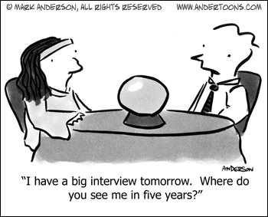
Where do you see yourself in five years?
Photo by: andertoons.com
*Source : http://www.andertoons.com/fortune/cartoon/5517/i-have-big-interview-tomorrow-where-do-you-see-me-in-five-years

Slide 31
Summing it up…
Focus on them, not yourself
Tell stories
No contradiction
Do not pretend to be someone you are not

Slide 32
References
https://www.unigo.com/pay-for-college/scholarships/how-to-answer-common-scholarship-interview-questions
http://www.best-job-interview.com/internship-interview.html
http://www.job-hunt.org/recruiters/smart-job-interview-answers.shtml
http://work.chron.com/clever-ways-answer-questions-job-interview-26744.html
https://collegegrad.com/jobsearch/mastering-the-interview/ten-tough-interview-questions-and-ten-great-answers
https://www.themuse.com/advice/how-to-answer-the-31-most-common-interview-questions
http://i2.wp.com/masetv.com/wp-content/uploads/2013/09/Ridiculously-Saggy-Pants-02.jpg?resize=600%2C400
http://img11.deviantart.net/c1b3/i/2009/023/9/a/brokenandgone2_by_conhopper.jpg
http://fun2video.in/wp-content/uploads/2013/07/pineapple-hair-of-crazy-man.jpg
http://asapdentist.com/wp-content/uploads/2014/09/what-is-causing-my-bad-breath.jpg
http://i.dailymail.co.uk/i/pix/2009/01/07/article-1107628-02F7B77E000005DC-186_468x163.jpg
https://cdn.psychologytoday.com/sites/default/files/blogs/5020/2014/01/142239-143369.jpg
http://i.huffpost.com/gen/3710646/images/o-CONDOM-CHALLENGE-DFI-RSEAUX-SOCIAUX-facebook.jpg
http://cals.arizona.edu/clubs/manrrs/MANRRS%20Web/GENERAL%20INTERVIEW%20TIPS.pdf
http://au.hudson.com/job-seekers/helpful-tips-career-advice/interview-preparation/interview-tips
https://www.daysoftheyear.com/days/drink-wine-day/

Slide 33
Q&A

